Slide 1
OGC-Preview / Feature Browser User Guide
A brief overview on OGC Preview/Feature Browser’s user interface

Slide 2
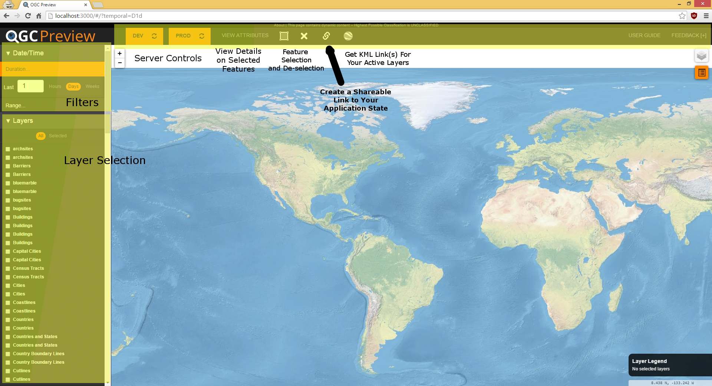
Main Interface

Slide 3
Interface Explained
Filters
Date/Time
A variety of filters will be developed for managing the amount of data displayed. Currently, date and time filtering is possible via a duration or a range selector.
Layers
A listing of available geospatial layer information will be displayed with a checkbox. Checking the box turns the layer’s information display on and off.
Server Controls
Configured Geoserver names will be displayed. By default, all configured servers will be turned on and highlighted as to be shown as “active.” Clicked the name of the server will turn it on and off. Clicking the refresh button next to the server name will force a refresh of all the layer data associated with that server.
View Attributes
After selecting a region on the map via the square selection tool the right of this button, a popup will appear with all the attributes of selected layers.
Attribute Selection
Square-looking selection tool will allow a rectangular region to be drawn on the map. This area will be “in focus” for the view attributes button.
Attribute De-selection
This will deselect the region drawn on the map.
Application State Link
This button will generate a shareable link to your current applications’ state. It will preserve selected layers and filters.
KML Links
This button will generate KML file for the layers selected. If more than one server’s layers are selected, a link for each server will be generated for use outside the tool.

Slide 4
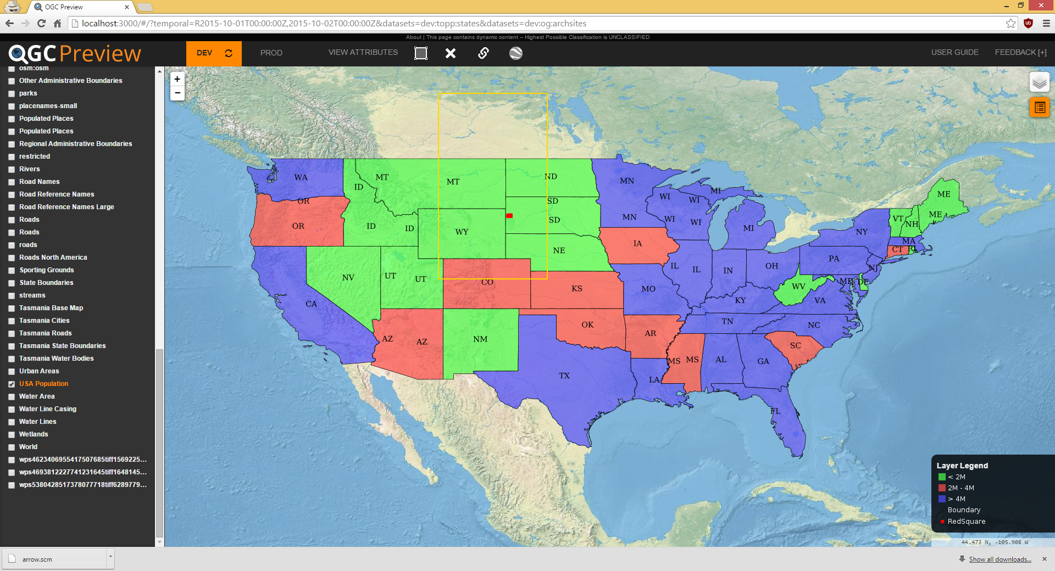
Selected Layers

Slide 5
Selected Layers
Selecting layers on the left hand side bar causes the layers to appear on the map.
In the previous screen, several layers are selected and their associated legend information is displayed in the bottom right corner.
A bounding box is created via the attribute selection tool.
In the previous screen, you can also see that I only have the “dev” Geoserver active, “prod” is turned off.
In the previous screen, you can also see that the URL is updated to preserve the current filter and layer display

Slide 6
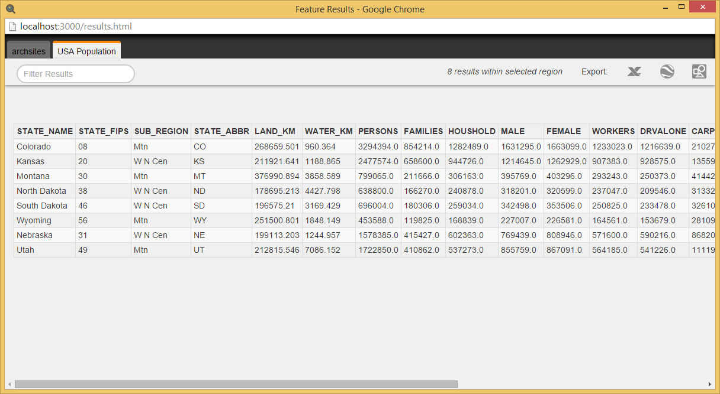
Viewing Attributes

Slide 7
Viewing Attributes
After my selection, I hit “View Attributes.”
This caused a popup as shown on the previous slide displaying the two layers I had selected that are inside the region I made.
Here you can view feature information as well as export the information in a variety of formats: CSV, KML, and SHP files.
You can also further filter the results based on text/name.

